Slide 1
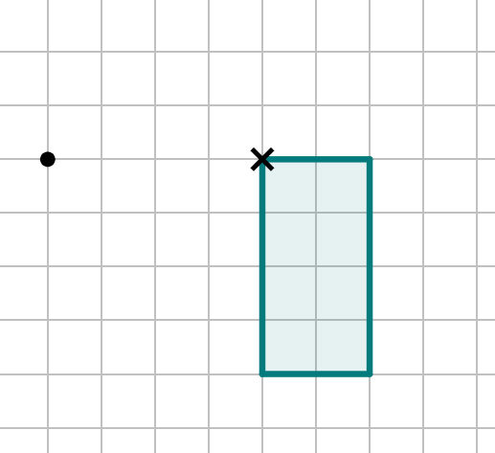
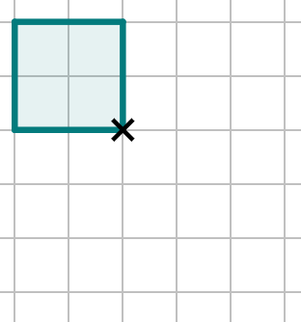
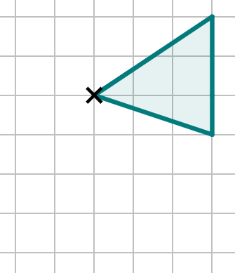
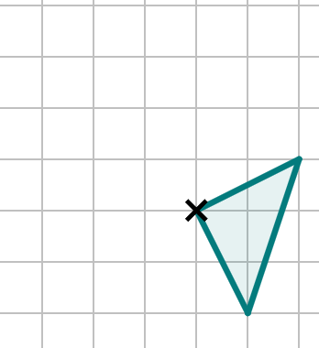
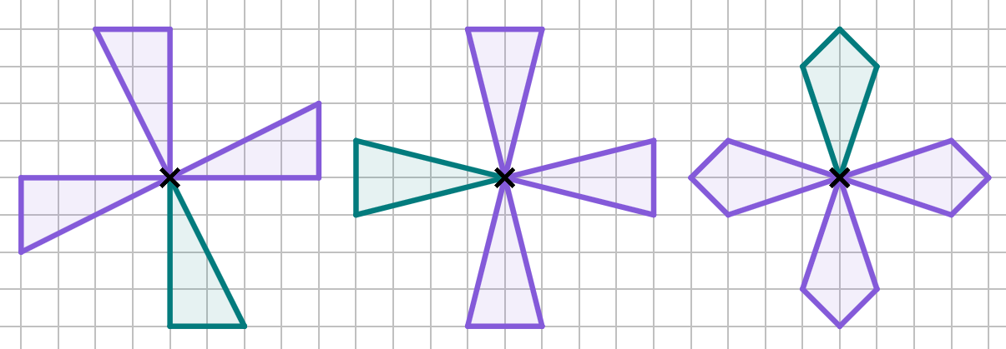
Rotating objects
Task A: Rotating with tracing paper and centre on a vertex
1) Rotate the object by 90° clockwise about the centre of rotation that is labelled onto the vertex of the shape.
One of the vertices of your image should overlap with the on the grid.
2) Rotate the following objects about the centre of rotation that is labelled with a cross.
rotate 180°
rotate 90°
clockwise
rotate 90°
anti-clockwise
3) Rotate each shape clockwise by 90° around the centre of rotation given. Repeat this rotation two more times, but each time start from the image you have just drawn, and treat that as the new object.
The result of each three rotations should look like a pinwheel or windmill.
1

Slide 2
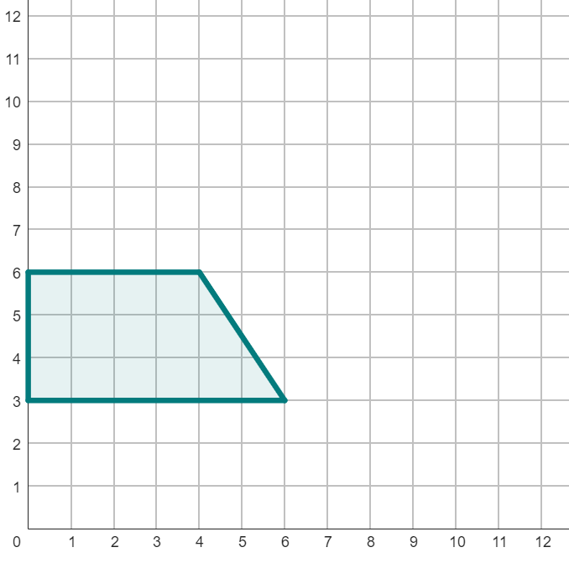
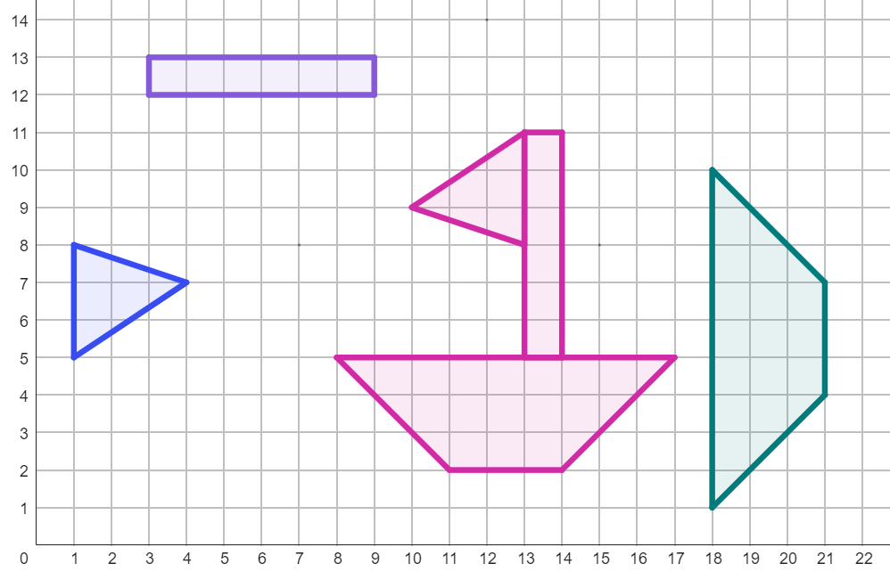
Rotating objects
Task B: Rotating objects with centre outside the object
1) Rotate object A by 90° clockwise around the point (7, 5).
2) Rotate object A by 90° clockwise around the point (6, 0).
object A
3) Follow the instructions to rotate each object below so the images combine to create a picture.
90° anti-clockwise
centre around (12, 14)
90° clockwise
centre around (15, 8)
180°
centre around (7, 8)
2
v2.1

Slide 3
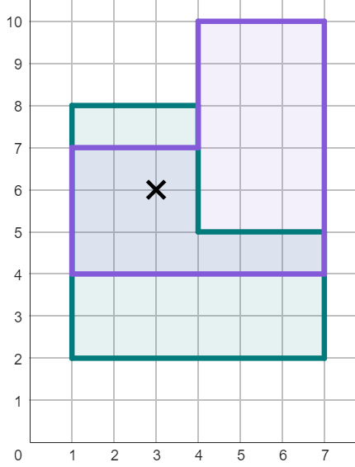
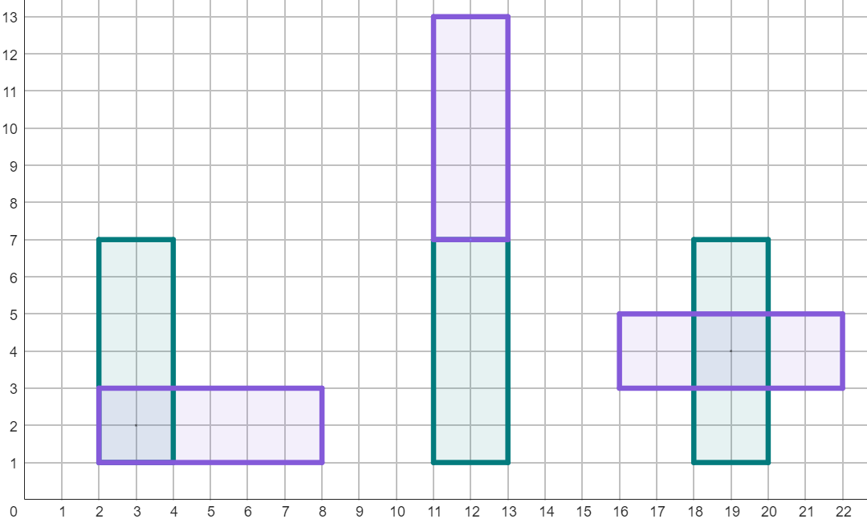
Rotating objects
Task C: Rotating objects with centre in or on the object
1) Rotate this shape by 90° anti-clockwise around the point (3, 6).
2) How many unit squares of overlap are there between the object and its image?
3) Rotate each of these rectangles by the descriptions given.
180°
centre around (12, 7)
270° anti-clockwise
centre around (3, 2)
450° anti-clockwise
centre around (19, 4)
Mathematics in Education and Industry

